Slide 1
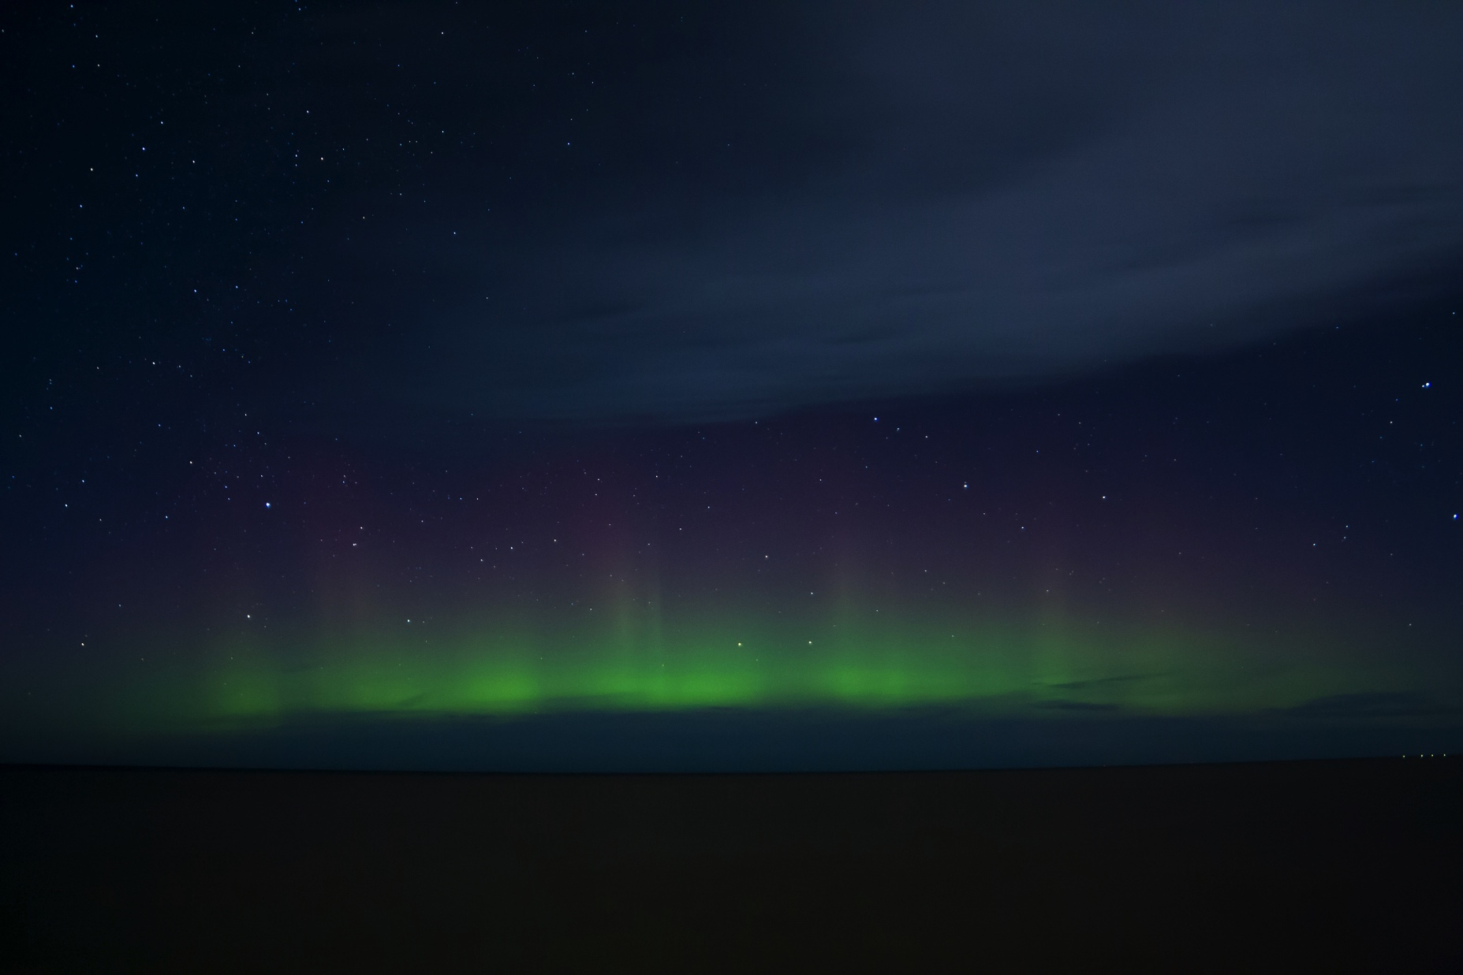
The Wisdom of Change:
Positivity and Resilience Under Stress
Maria Sirois, Psy.D.
msirois@wholeleader.com
Notes:
Hollyhock – Vancouver Island – hot tub moment
Without that moment - never seen the northern lights, bioluminescnece

Slide 2
“To be hopeful in bad times is not just foolishly romantic.
It is based on the fact that human history is a history not only of cruelty,
but also of compassion, sacrifice, courage, kindness.
What we choose to emphasize in this complex history will determine our lives.
If we see only the worst, it destroys our capacity to do something. If we remember
those times and places - and there are so many - where people have behaved magnificently,
this gives us the energy to act, and at least the possibility of sending this spinning top
of the world in a different direction. And if we do act, in however small way,
we don’t have to wait for some grand utopian future.
The future is an infinite succession of presents, and to live now as we think human beings
should live, in defiance of all that is bad around us, is itself a marvelous victory.”
Howard Zinn
Notes:
How many of you have had a dark difficult htought recently about your country and it’s future?
How many of us are worreid about the generations of the young – their depression, anxiety, suicidaliyt – in this country their saftey guns in school
How many of us look in the mirror and think – really…this is what I have to deal with now?
Annoying relatives, difficult colleages, betrayal, illness, divorce…mountain lions on the trail…lifecan be dark

Slide 3
1. Focus on the Good…
Delight
Hope
Pride
Kindness
Love
Passion
Gratitude
Joy
Curiosity
Awe
Notes:
Positivity builds Success
Broaden and Build
Our brains are at our best…

Slide 4
1. Focus on the Good…
Ask a Better Question
Celebrate Small Wins
Best Moment of the Day

Slide 5
2. Reduce Negative Thoughts
Notes:
Jumpers
Catatrophize
Max/Min
Personalize
Externalize

Slide 6
2. Reduce Negative Thoughts
Notes:
Jumpers
Catatrophize
Max/Min
Personalize
Externalize

Slide 7
2. Reduce Negative Thoughts
A more likely outcome…
A more accurate way of seeing this…
My thoughts are not necessarily true because (list evidence)…
One possible other explanation…
Reivich and Shatte
The Resilience Factor

Slide 8
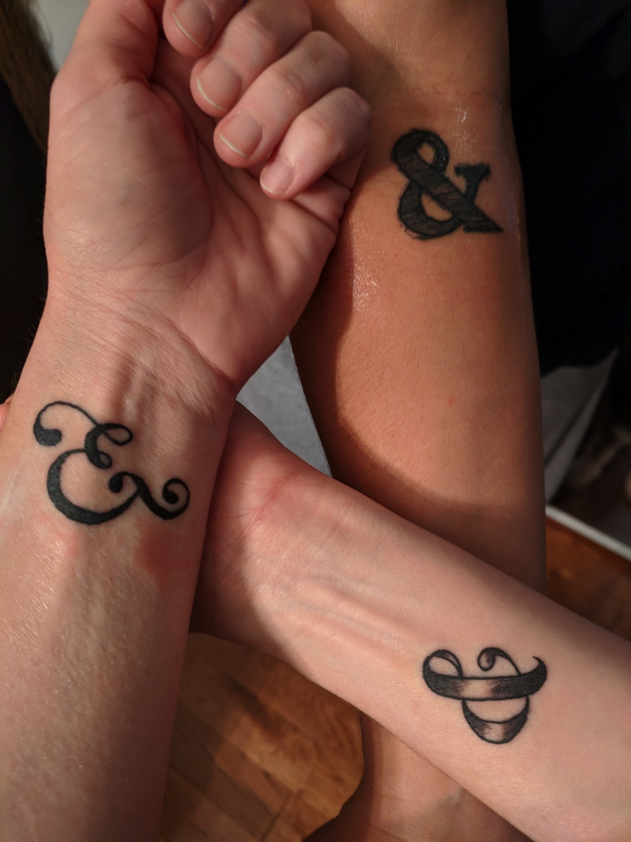
3. Activate True Hope
Face Reality
As It is…
Create a Slightly
Better Future…Each Day.
Notes:
Build in the AND

Slide 9
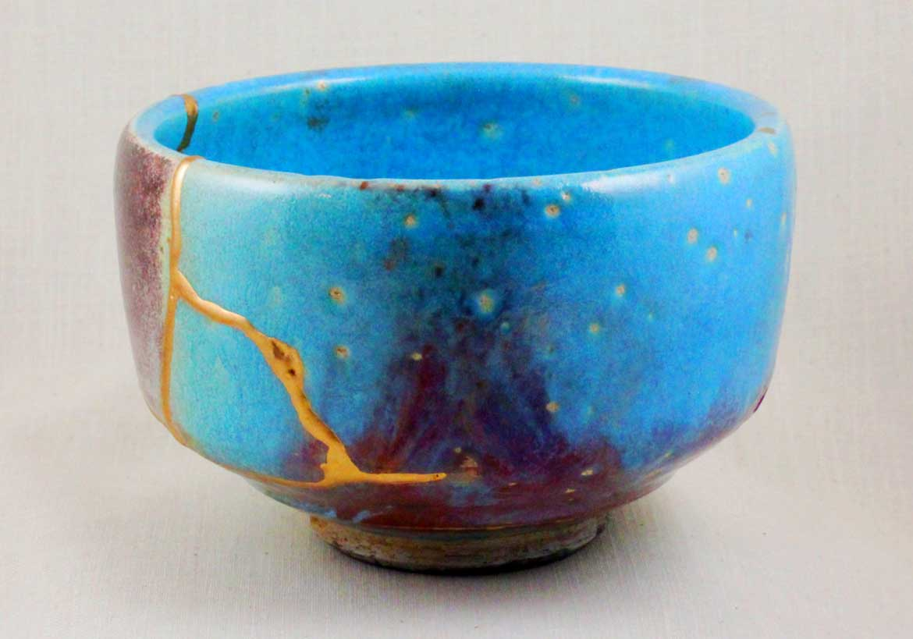
4. Live Into Paradox
Notes:
Activates Who we Are At our best

Slide 10
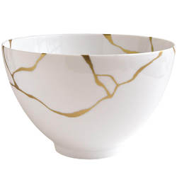
4. Live Into Paradox
Imperfect and Magnificent
Failed and Growing
Vulnerable and Brave
Anxious and Hopeful
Broken and Whole

Slide 11
5. Care for the Self to Care for Others
Self Care (Nourishment)
Self Regard (Respect)
Self Compassion (Kindness)
Self Esteem (Courage)
Saying No (Boundaries)
Saying Yes (Choose Life)
Notes:
Gander Newfoundland

