Slide 1
Lac-Mégantic The THEN and NOW… …and everything in between!

Slide 2
PART 1 – A few facts on Lac-Mégantic

Slide 3
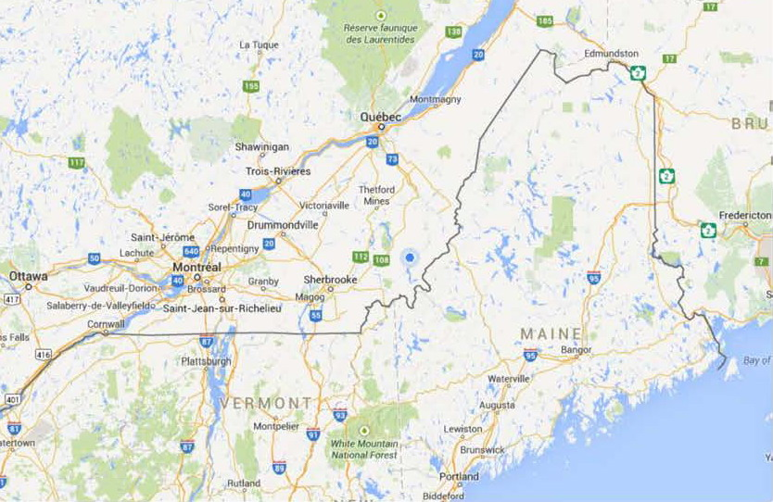
Lac-Mégantic
Lac-Mégantic, Qc, Canada
Notes:
First, where is Lac-Mégantic?
250 km from Mtl
180 km from Québec City
Roughly 400km from Bangor MA.
5200km from Vancouver!

Slide 4
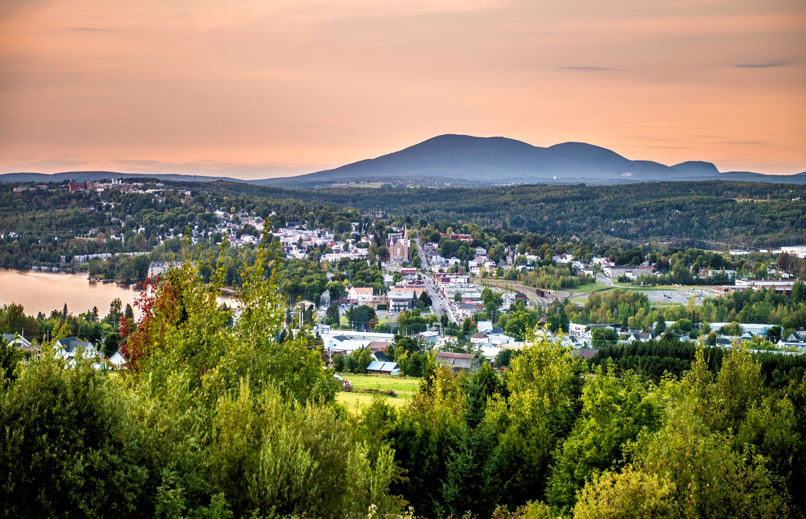
Photo : Claude Grenier

Slide 5
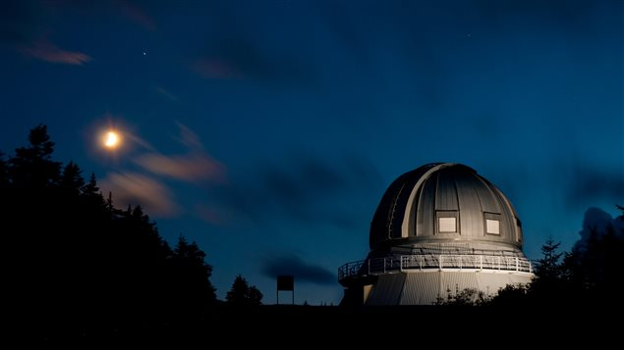

Slide 6
PART 1 – A few facts on the Tragedy

Slide 7
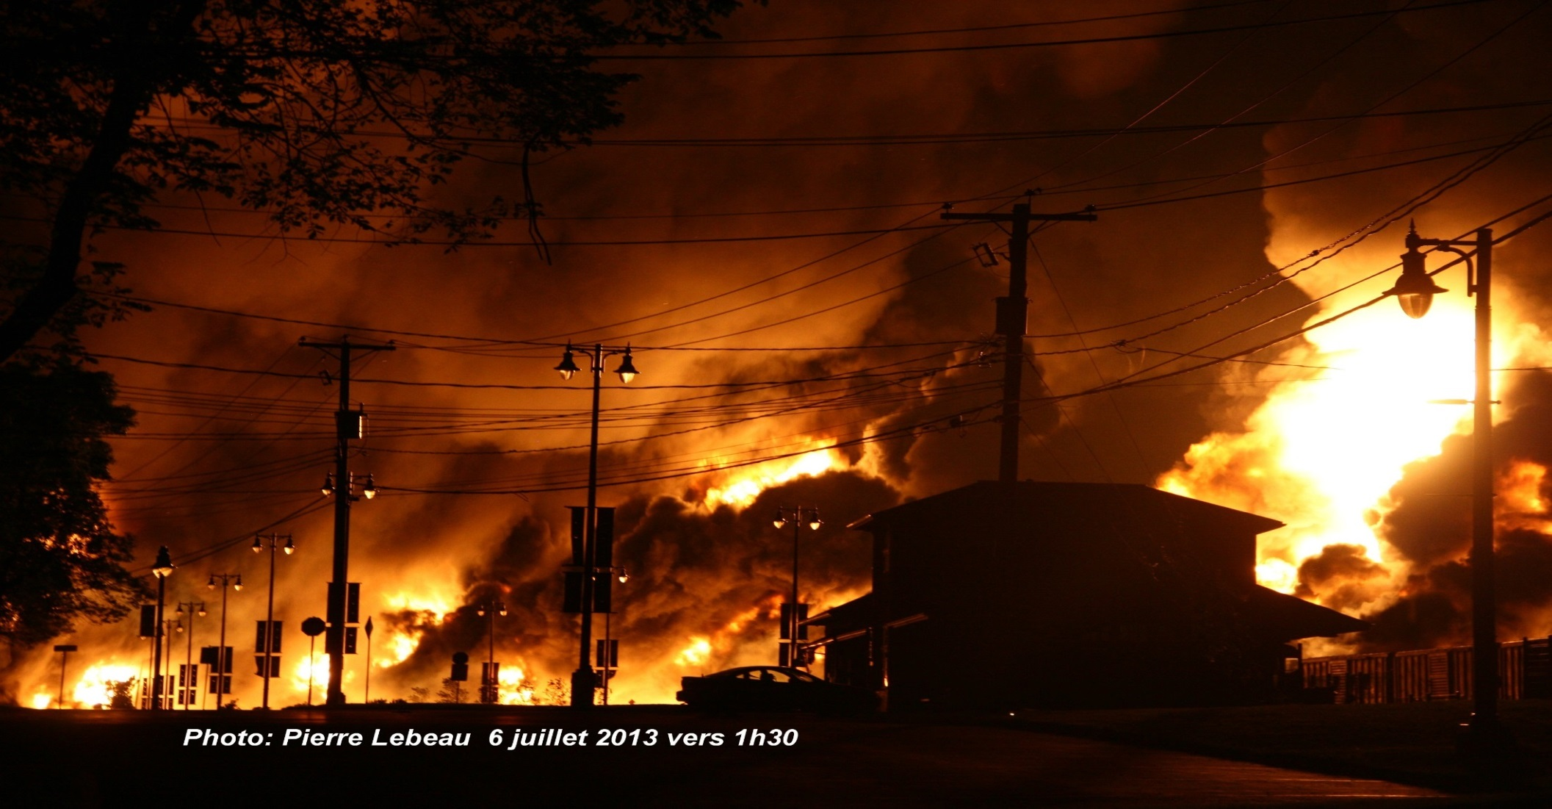

Slide 9
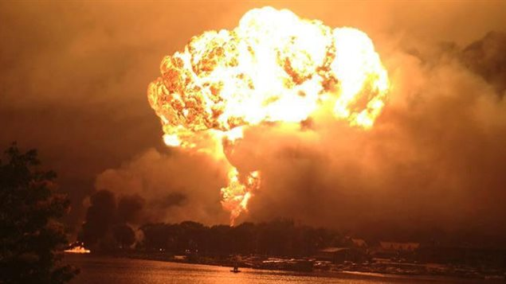
Notes:
A few general facts before going into a bit more details.
- Directly impacted area: 171 925 m2 (42.5 acres) – that’s nearly 40 american football fields.
- Additional indirectly impacted area: 83 750 m2 (20.7 acres)
- Train: 5x locomotives (or engine cars), 1 buffer wagon, 72 tk cars (63 derailed) – Each containing 116 000 litres of crude oil.
- Derailment created a series 63 murderous explosions, back to back, each representing 1/16th of the explosion power observed in Hiroshima
- Train lenght: 1 433m (4700 ft)
- Train weight: 10 873 metric tons or 23 869 450 lbs!
- Distance Nantes-Lac-Mégantic: 12 km
- Estimated speed at derailment: 100km/h
- Depth of contamination: 9.3ft
- 150 000 m3 contaminated soil = over 50 olympic size pools
125 fire services involved in the firefight. 200 offered their services. The response was simply amazing but we simply could not accept all the help that was being offered.
2000 people evacuated – 1/3 of the population.
47 deaths.
X buildings burnt of which _____ were businesses and ____ were households.
39 buildings destroyed over a year after. Of those, ______ were businesses and _____ were households.
_________________________________
Quelques faits :
-Zone directement touchée: 171 925 m2 (42,5 acres) c'est près de 40 terrains de football.
Superficie supplémentaire indirectement touchée: 83 750 m2 (20,7 acres)
Train: 5 locomotives (ou voitures-moteur), 1 wagon tampon, 72 wagons (63 déraillés) - Chacun d'eux contenant 116 000 litres de pétrole brut très instable.
Longueur du train: 1 433m (4700 pi)
Poids du train: 10 873 tonnes métriques ou 23 869 450 livres!
Distance Nantes-Lac-Mégantic: 12 km
Vitesse estimée au déraillement: 100 km/h

Slide 10
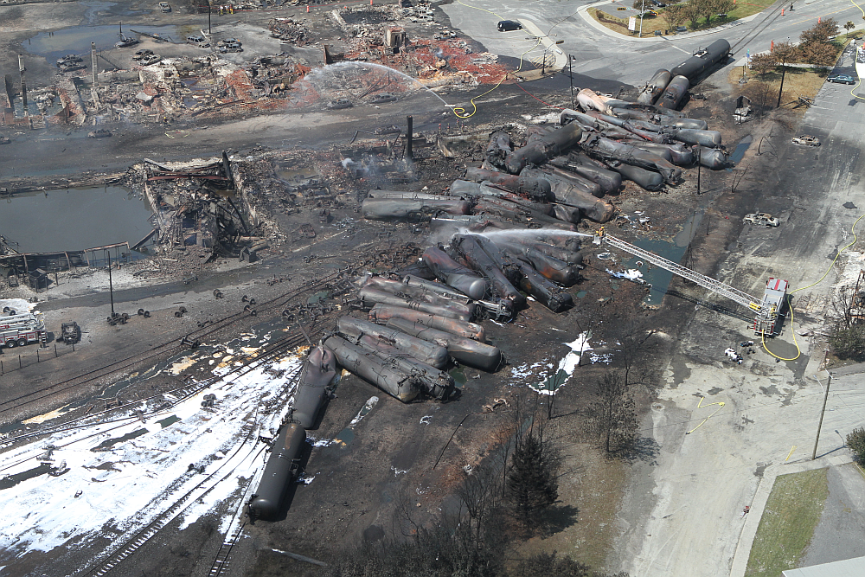
Photo : BST

Slide 11
PART 2 – The Response

Slide 13
COMMAND AND cONTROL
Governance
Town’s Leadership
Interoperability
Information flow
Schedule coord
Logistic coord
Evacuation
Tackling the main concerns
Enviro
Safety
Health
Provide guidance to stakeholders like the Red-Cross.
Define roles of each.
COMMS
LO SQ
FIRE
LO MSP
SAS
COORD
Multi Media System
PUB WKS
COORD
2I/C
IT
SUPP & FIN
SECRETARY
ENVIRO

Slide 14
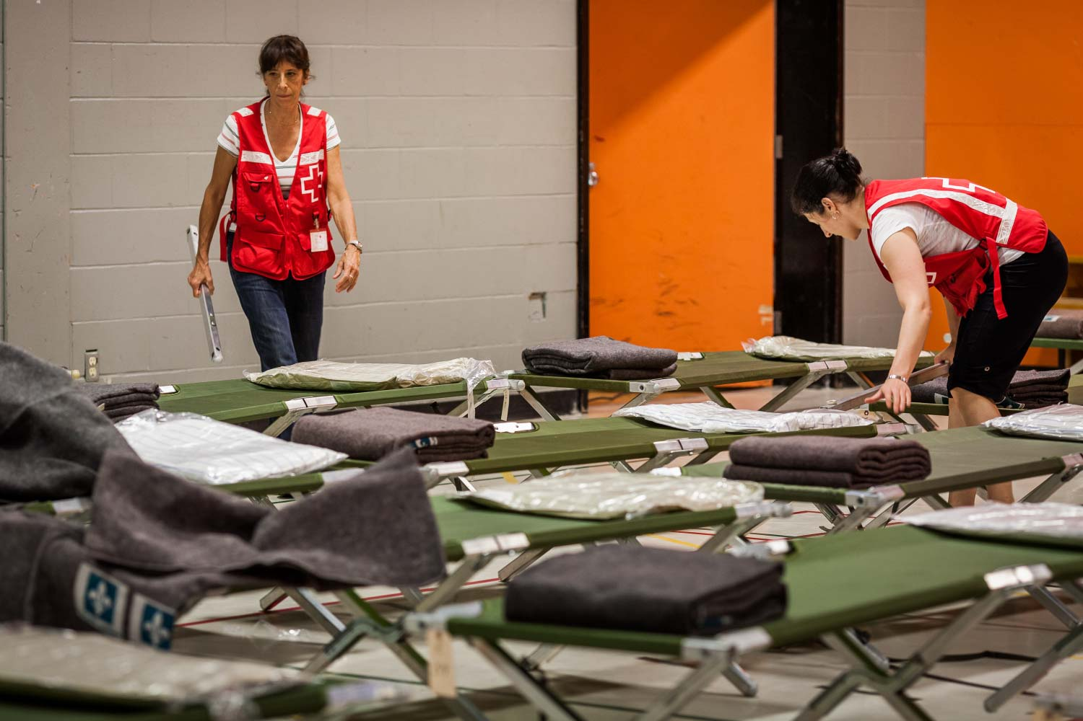
THE VOLUNTEERS AND EMERGENCY RESPONSE WORKERS

Slide 15
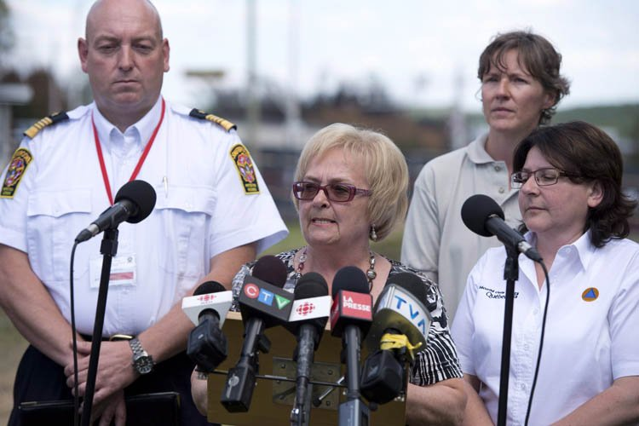
COMMUNICATIONS

Slide 16
PART 3 – The long road to recovery

Slide 17
THE REALITY

Slide 18
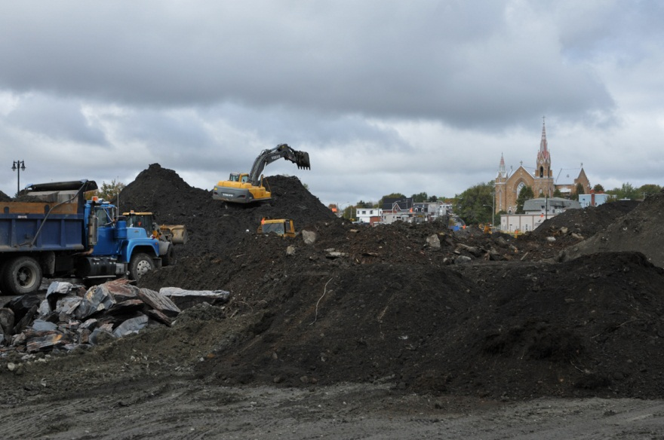
Notes:
Soil management!
Running out of place.

Slide 19
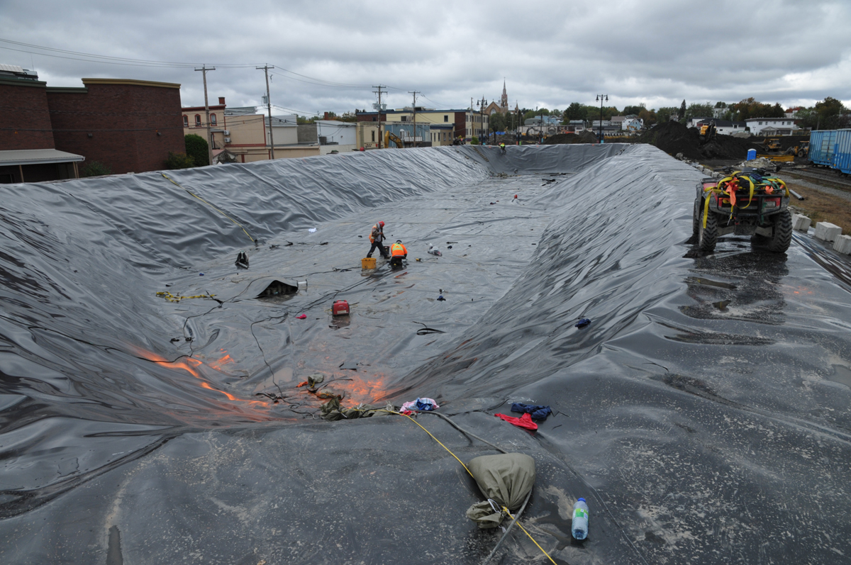
Notes:
What to do with all this contaminated water?
Must contain it and treat it so it does not spread and contaminate any further.

Slide 20
WITH REALITY COMES HARD DECISIONS MAKING HARD DECISIONS FOR THE COLLECTIVE GOOD
Notes:
As a leader:
You have to be willing and most importantly capable of making hard decisions for the collective goods.
You will be faced with situations and have to ask yourselves fundamental questions such as ‘’what’s truly important here?’’
What follows sre some examples of difficult decisions that needed to be made by Lac-Mégantic’s Leaders since 2013. Certainly, not decisions I expected having to make when I started my adventure in LM.

Slide 21
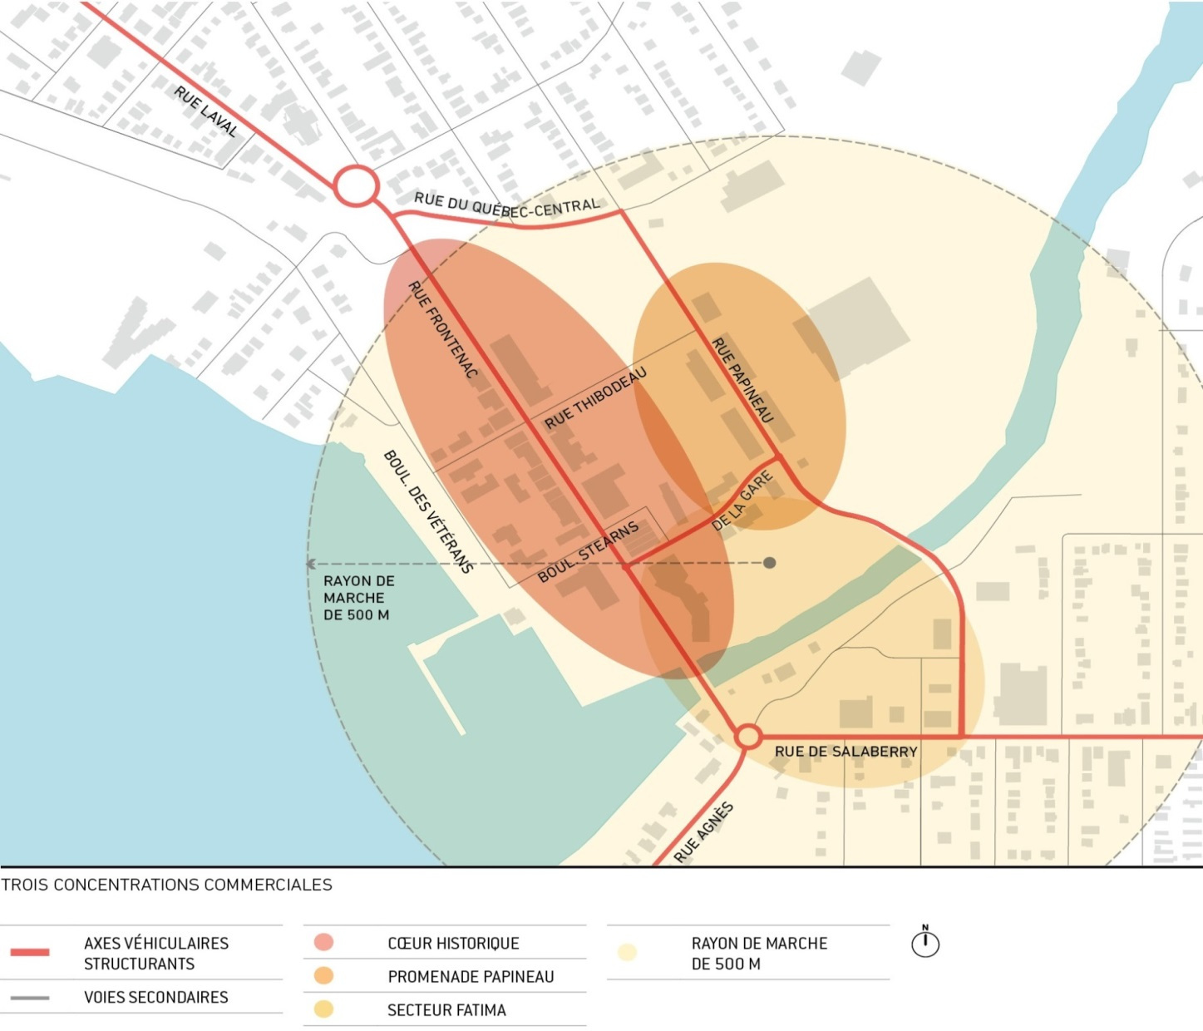
HARD DECISION 1 - ZONAGE
Centre-ville
historique
Nouveaux secteurs
commerciaux
Notes:
Explain that quickly, business owners decided to relocate elsewhere. Our response….
We had the duty to think about the future, to think long term. We had to ask ourselves What’s truly important now
To anser, we had to think rationally as opposed to emotionally.
That also meant telling the people that had just lived a trauma, the oposite of what they wanted to hear.
No you will not relocate your business where you plan to…a city small or big needs a downtown core. Allowing it to spread it and dispurse its business all over is the recipe for failure. The fire just inflicyted a huge wound to our city. Allowing the businesses to spread all over and therefore placing the conditions in place for making it improbable to regain a true downtown in the future was going to be atal and kill the city.
Leadership competency needed here: knowledge and skills. As a leader that will have to make hard decisions:
you need to be proficient in your job in order to be credible. Junior levels, more technical and hands-on. As you move up to more senior levels of leadership, knowledge of the institution is necessary.
You need courage.
You need empathy.

Slide 22
HARD DECISION 2 - EXPROPRIATIONS
Centre-ville
historique
Nouveaux secteurs
commerciaux
Notes:
If we blocked the businesses from relocating elsewhere within town or even worst outside town, we needed to quickly come up with proposals on where they could go becaude going back in the historical downtown was not possible for a long time.
We built a new commercial sector for small businesses but it wasn’t appropriate for our bigger commercial anchors.
Not many options….
Second very difficult decison that had to be made by our city leaders: Expropriate a residential part of town to make room for a new commercial sector. Economically, the city could not afford to lose those commercial anchors…
In terms of leadership competencies - the city leaders here had to demonstrated very strong social capacities as well as strong cognitive abilities.
**Social capacities : emotional intelligence, negociating skills
**Cognitive abilities: creative problem solving and being agents of change
Imagine….and remember the context…Seems easy to say but when comes time to put it nto practise, it requires courage.

Slide 23
HARD DECISION 3 - DEMOLITION
Notes:
Talking of courage.
Here is another difficult decision that had to be made by the city leaders. Probably the most difficult one.
1.5 yrs later - Demolition of all buildings that survived the fire. Explain why.
Here we touch all facets of leadership competencies in order to make, announce and live by this decision. But those who stand out to me are values-based leadership and personality.
Values-based leadership
Here again: as leaders we had to ask ourselves: what’s truly important? Need to have empathy. Think rationally for those who are still in the emotional. They can’t accept that what’s happened happened and will not change. Everything , every decision after – they feel like victims.

Slide 24
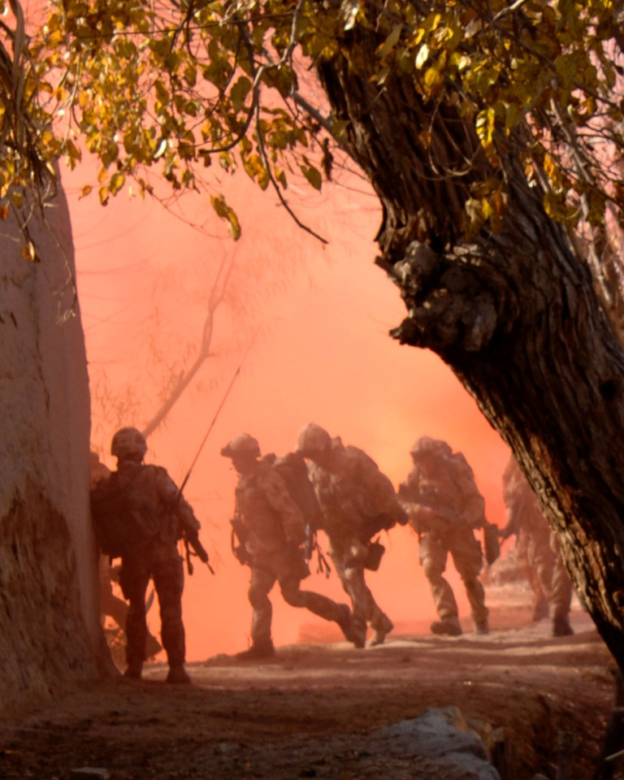
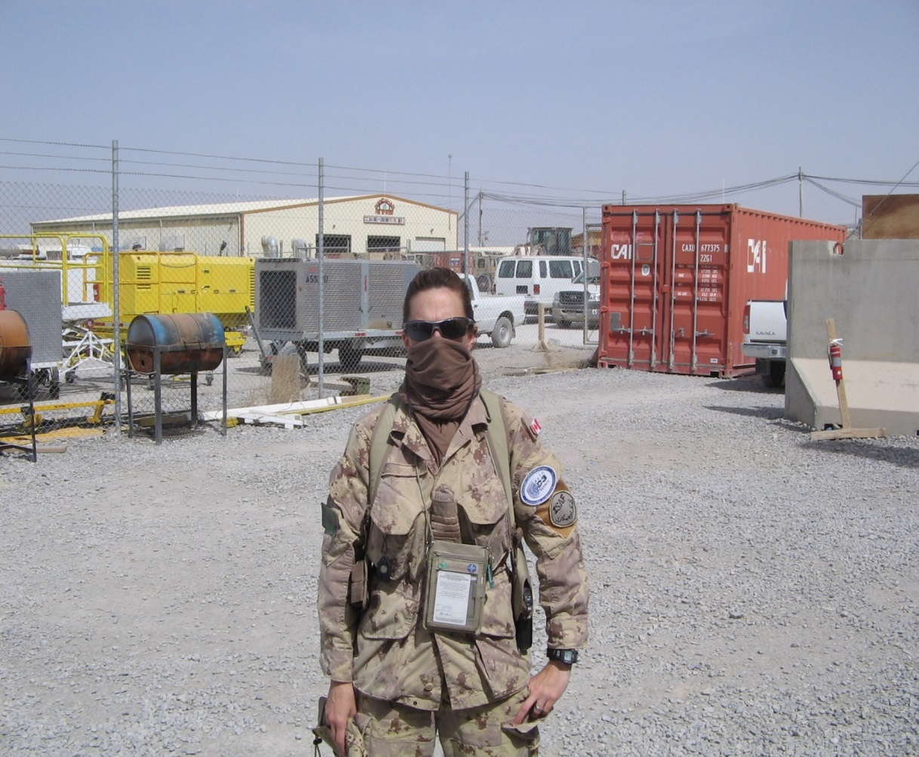
PART 4 – The only way to succeed RESILIENT LEADERSHIP

Slide 25
But what is resilient leadership? Back to basics: Be competent Believe in the vision and carry it on despite…. Be authentic

Slide 26
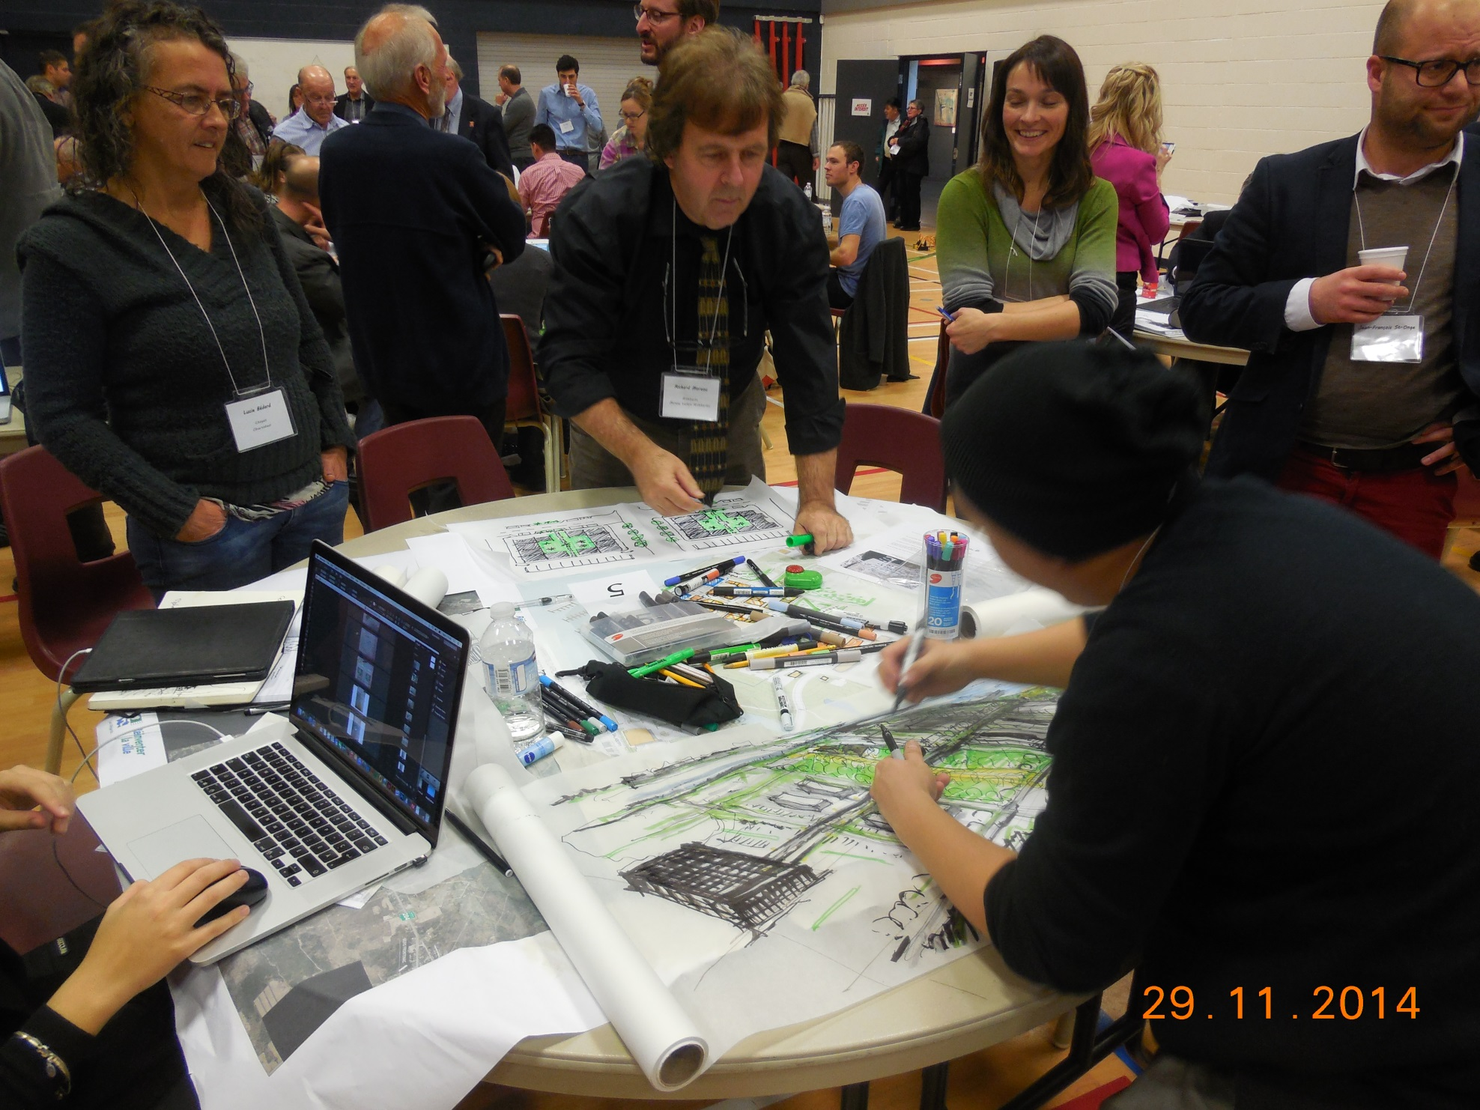

Slide 28
LAC-MÉGANTIC NOW

Slide 29
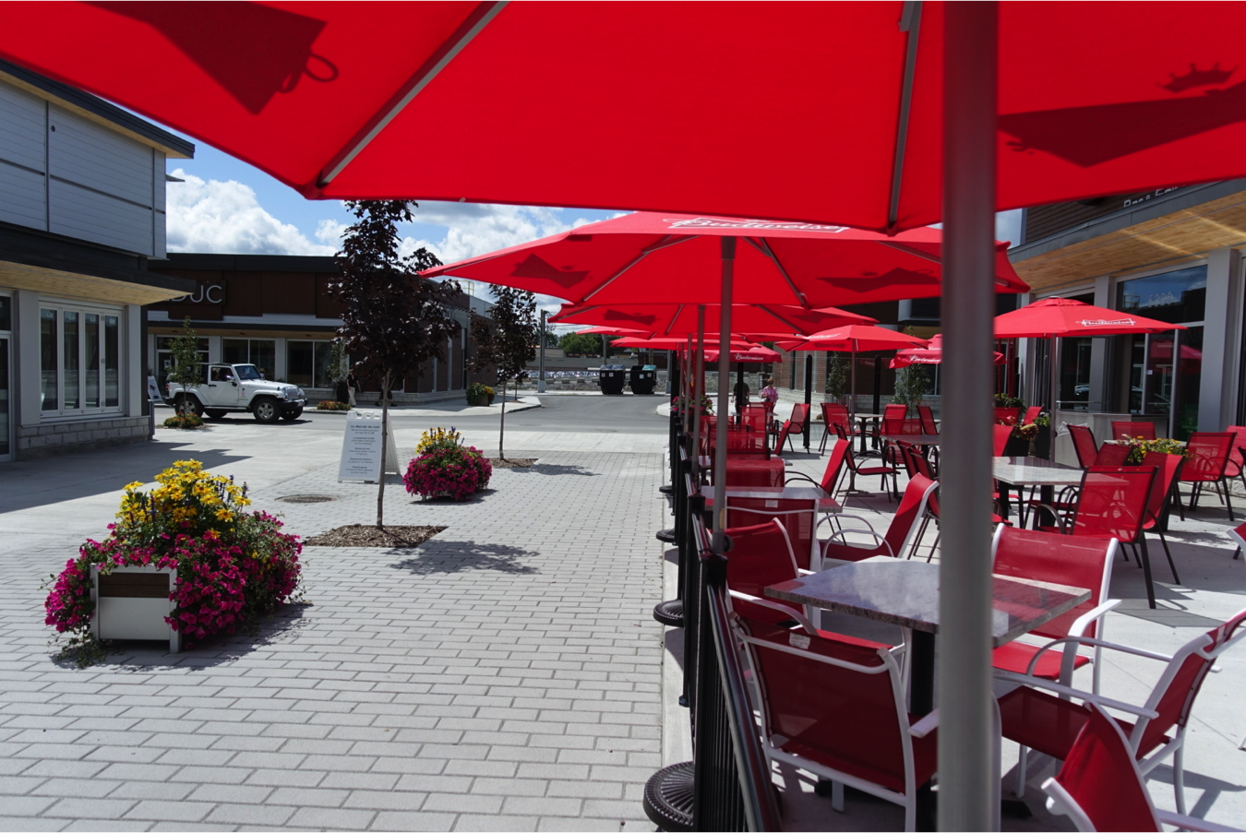

Slide 30
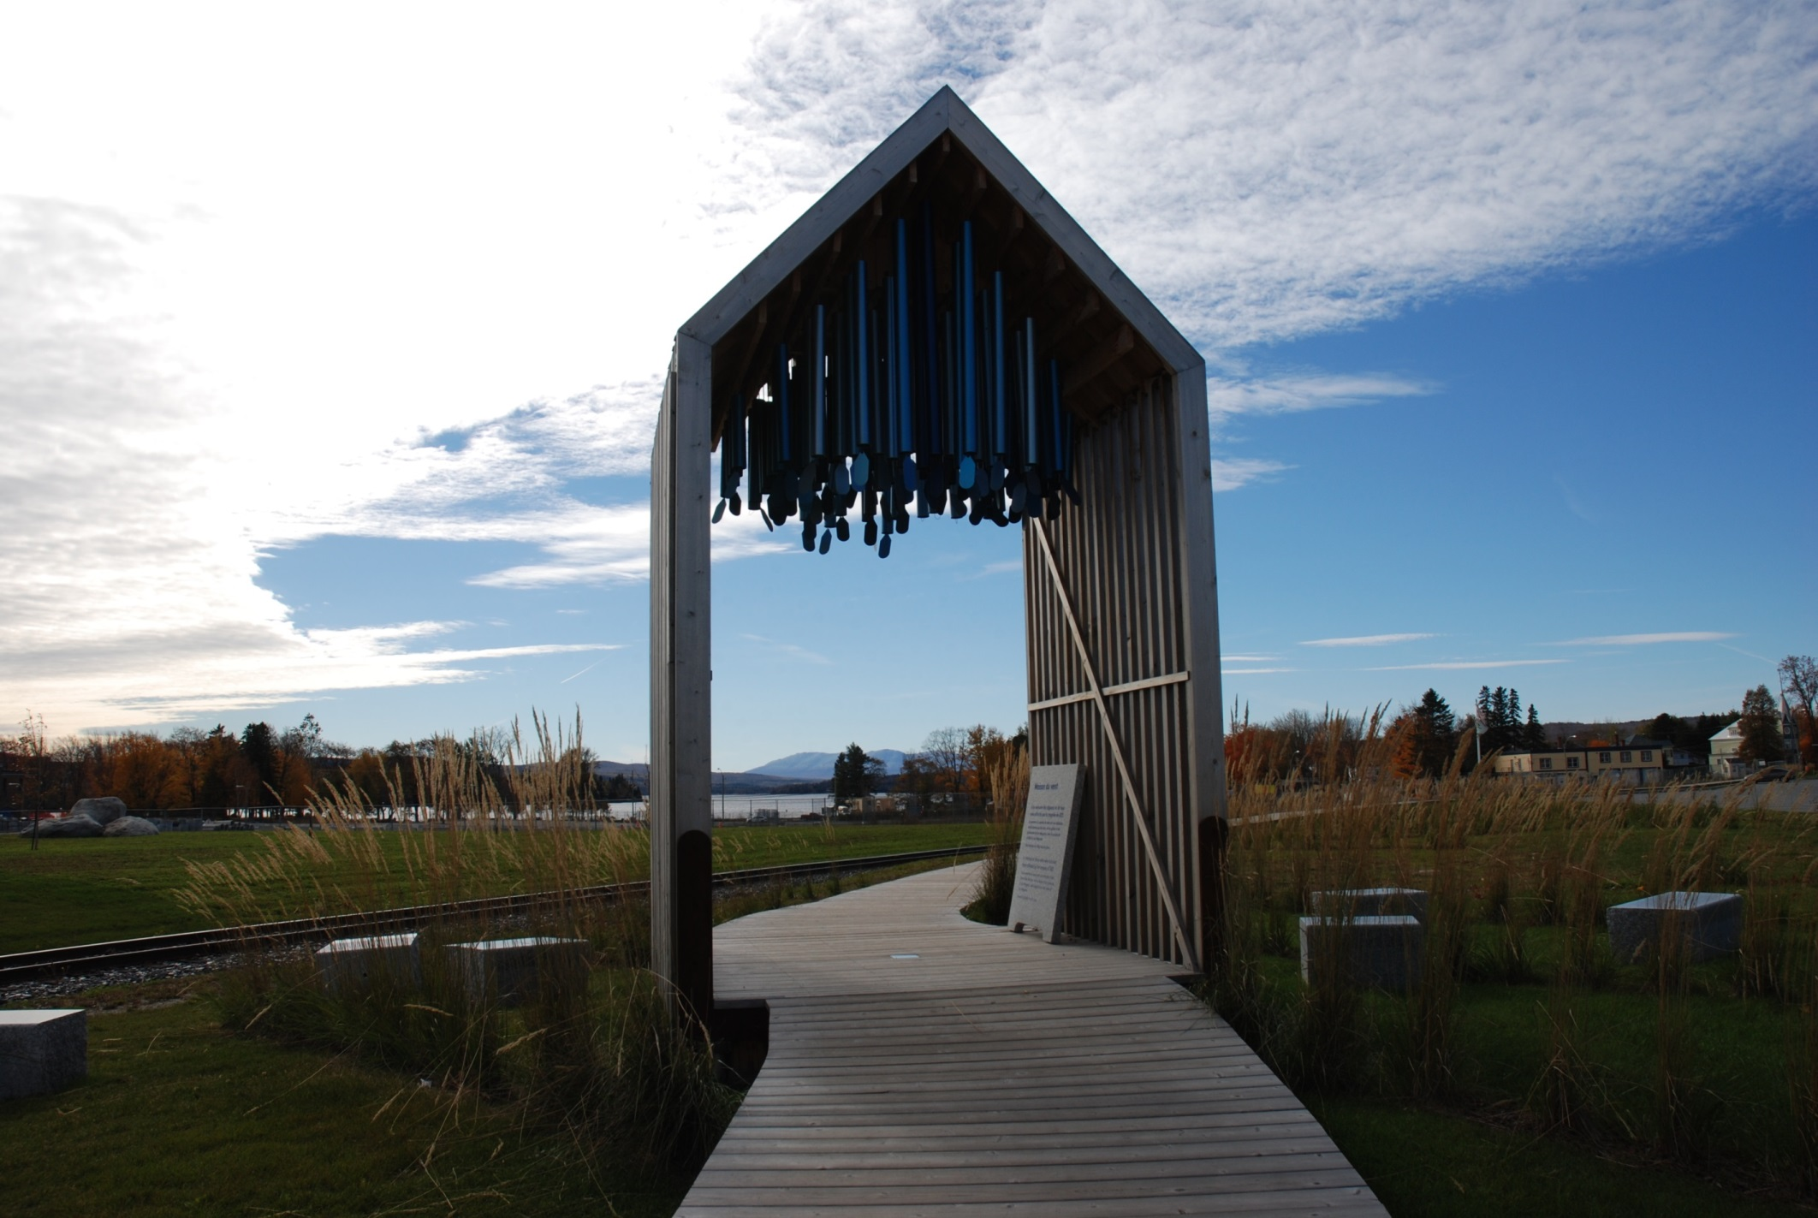

Slide 31
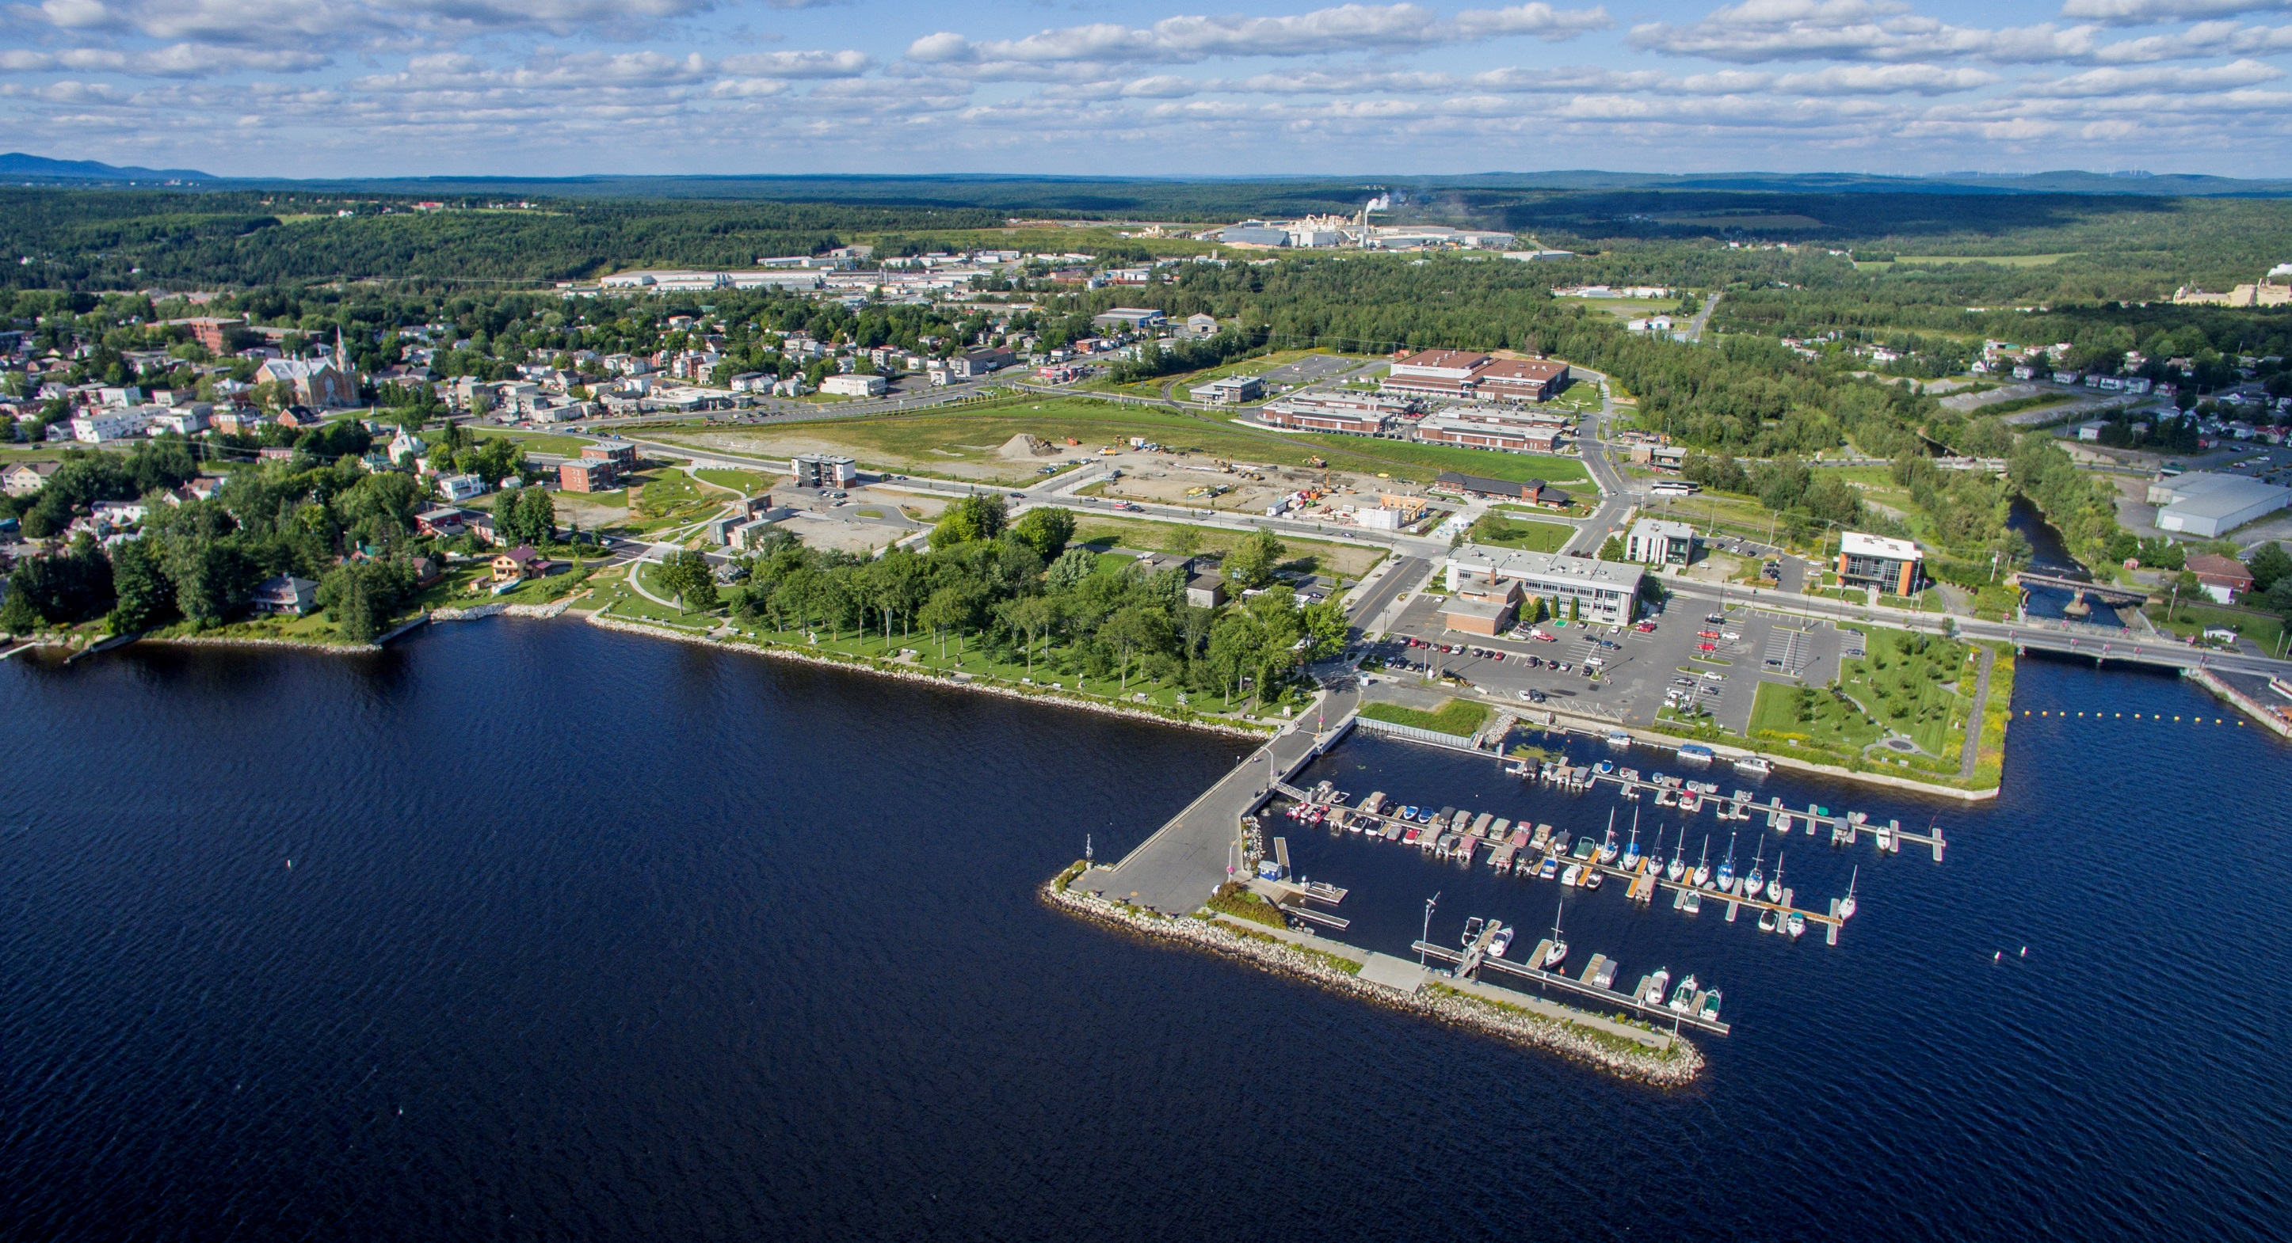

Slide 32
QUESTIONS?

